Slide 1

Software Testing Basics
By Usman Jilani

Slide 2
Introduction of Software Testing and its Importance:
Software Testing is a method to check whether the actual software product matches expected requirements and to ensure that software product is Defect free.
Software testing plays a vital role in delivering bug-free and high-quality software products. It helps in identifying and fixing defects early in the development cycle, reducing costs and risks. Additionally, thorough testing enhances customer satisfaction and improves the reputation of the software.

Slide 3
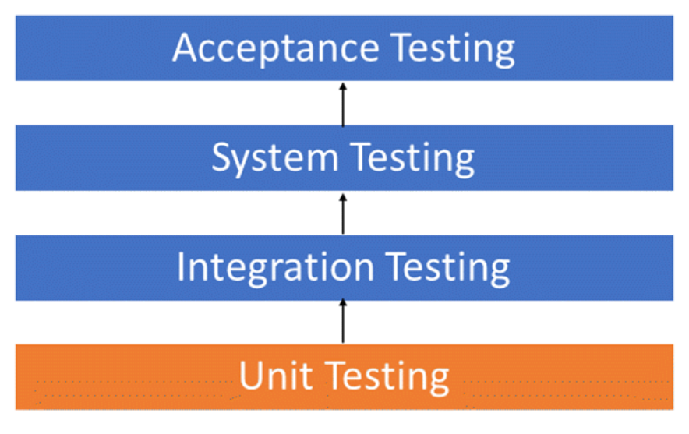
Levels of Testing:
Software testing consists of multiple levels, including unit testing, integration testing, system testing, and acceptance testing. Each level focuses on different aspects of the software. Unit testing verifies individual components, while integration testing checks the interaction between modules. System testing evaluates the entire system, and acceptance testing ensures compliance with user requirements.

Slide 4
Unit Testing
Unit testing is the first level of software testing. It involves testing individual modules or components to ensure their functionality and accuracy. By isolating each unit, defects can be easily identified and fixed. Unit tests are typically written by developers and executed using automated testing frameworks.

Slide 5
Integration Testing:
Integration testing focuses on verifying the interaction between different modules or components of a software system. It ensures that the integrated units function correctly together. By identifying interface issues and dependencies, integration testing helps prevent defects in the overall system.
Integration testing are pf two types
Incremental integration testing
Non incremental integration testing

Slide 6
System Testing:
o System testing of software or hardware is testing conducted on a complete, integrated system to evaluate the system's compliance with its specified requirements.
o System testing is carried out by specialists testers or independent testers.
o System testing should investigate both functional and non-functional requirements of the testing.
Types of System testing
o Black box testing o White box testing
o Gray box testing

Slide 7
Black box testing
A method of software testing that verifies the functionality of an application without having specific knowledge of the application's code/internal structure.
It is also known as functional testing. o Tests are based on requirements and functionality.
White box testing
It is a method of testing software that tests internal structures or workings of an application, as opposed to its functionality
It is also known as clear box testing, glass box testing, transparent box testing, and structural testing
Gray testing.
It is a combination of white-box testing and black-box testing.
The aim of this testing is to search for the defects if any due to improper structure or improper usage of applications.
For a complete software examination, both white box and black box tests are required.

Slide 8
Acceptance Testing:
In the acceptance testing phase, we test a system for its acceptability from the user’s perspective. The main goal of acceptance testing is to evaluate the system’s compliance with the business requirements. Based on this, we can assess whether the system is acceptable for delivery/release.
The users or clients carry out acceptance testing in a UAT environment. They validate the new features and once you get a GO, you can release the product. It is a form of black-box testing because the users who test the application do not know about the internal implementation of the code.

Slide 9
Conclusion:
Software testing is an essential part of the software development lifecycle. It ensures the delivery of reliable, high- quality software products. Through various levels of testing. defects and errors are identified early, reducing costs and risks. By prioritizing testing, organizations can enhance customer satisfaction and build a strong reputation.

